Slide 1
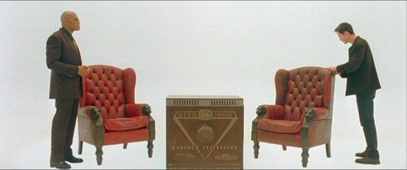
Nature of Reality
By Mitchell Long & Jarrah Lindhout
Notes:
Jarrah

Slide 2

Nature of Reality
Scientific Reasoning
Notes:
Jarrah

Slide 3

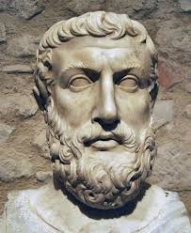
Ontology
Study of the nature of reality and what exists
Raises many questions, such as:
  What can be said to exist?
  What are the meanings of beings?
  What is a thing?
Can we ever answer these questions due to our inability to perceive an entirely objective reality?
Parmenides
Notes:
Jarrah
Study of the nature of reality, what exists, as well as the categories the beings and entities exist in.
Parmenides among the first to propose an ontological characterisation of the nature of reality.
Raises many questions, such as:
What can be said to exist?
What are the meanings of beings?
What is a thing.
Can we ever answer the

Slide 4
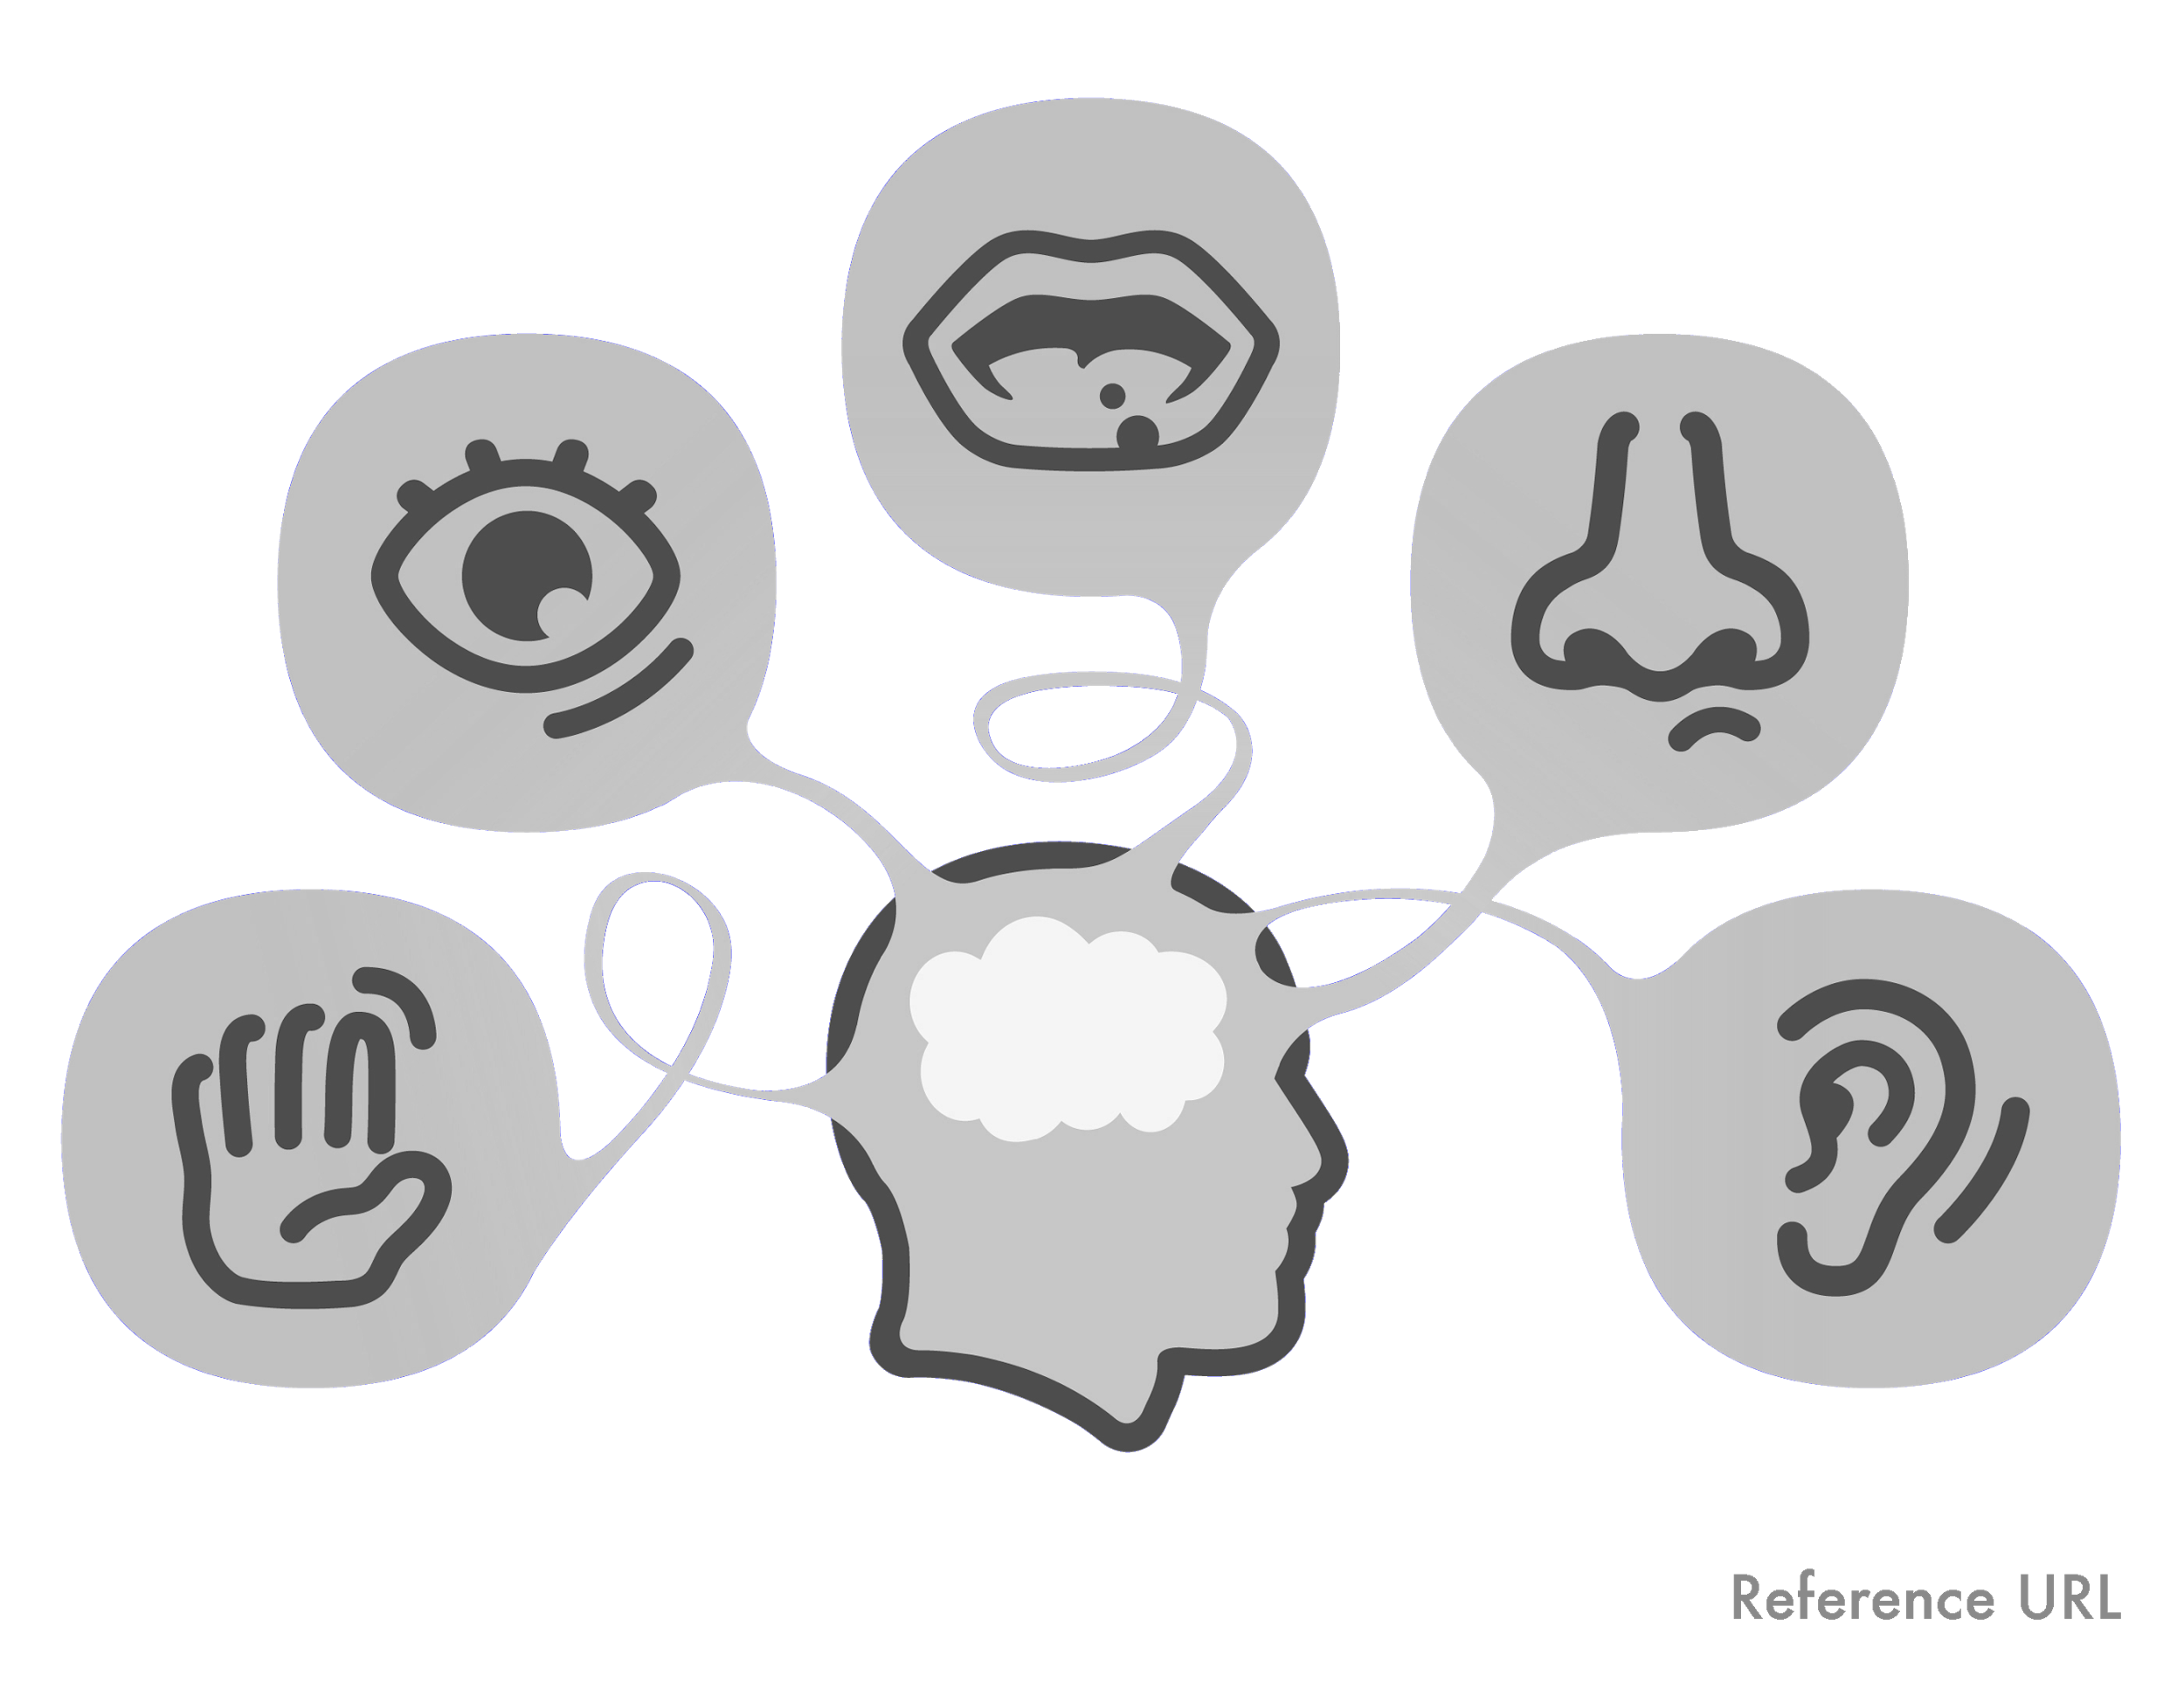
Neurological Perception
• Sight
• Touch
• Smell
• Taste
• Hearing
Notes:
Mitch
Sight
Eyes take in light
Brain forms an image that we can understand
Touch
Nerve endings send information to the brain about the sensation it has encountered
Smell
Olfactory receptor neurons detect the odour, and send the information to the brain
Taste
The brain interprets both gustatory and olfactory stimuli to generate a ‘flavour’.
Hearing
Sound waves move through the ear canal and hit the eardrum
Hearing nerves then communicate the information to the brain

Slide 5
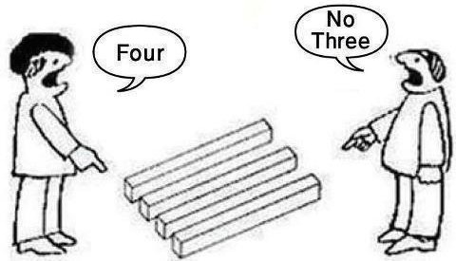
Perception vs Reality
All of our sensory perception is controlled by our brain
One part of our body is in control of our understanding of the world
If our brain is deceived, our perception of the world is also deceived
Optical illusions are a great example of how our mind can be tricked
Notes:
Jarrah
As shown in the previous slide, all of our sensory perception is controlled by our brain
This whole topic arises due to this fact; that one part of our body is in control of our sensory perception, and from that, our perception of the world
If our brain is deceived, our perception of the world would be altered, restricting our ability to interpret reality as it truly is
Optical illusions are a great example of how our mind can be deceived

Slide 6

Notes:
Mitch

Slide 7

Notes:
Mitch

Slide 8

Notes:
Mitch

Slide 9
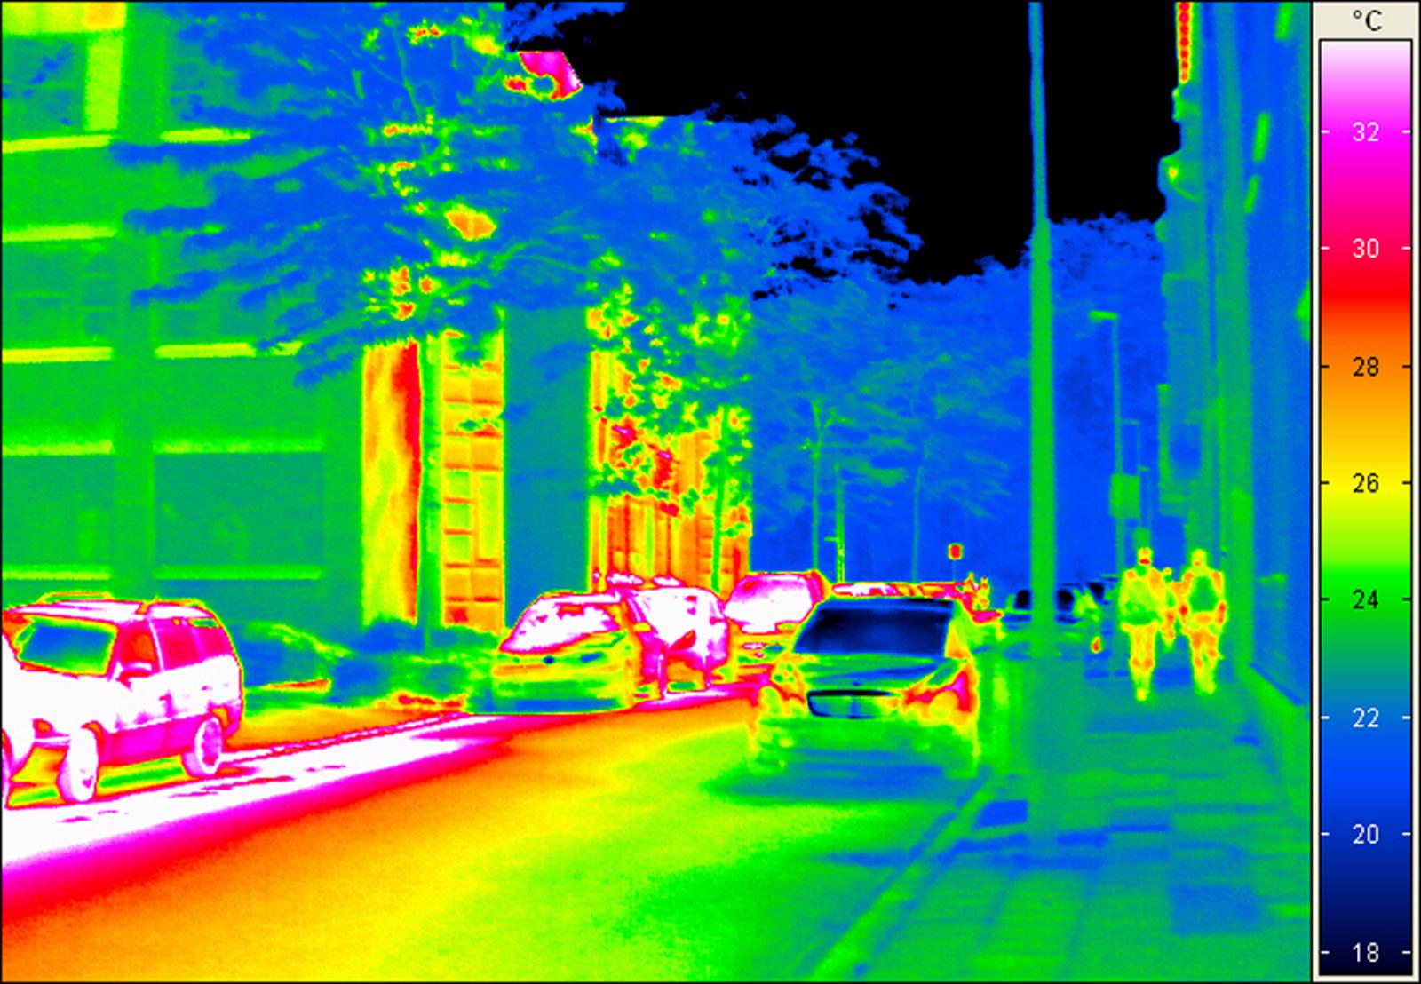
What We Don’t See
Our brain is also deprived of all the possible information out in the world
We can be deceived, but also omit information completely
Visible light, or the light we see makes up only a tiny fraction of all the information that is available to us.
Notes:
Mitch
· Optical illusions showed us that what we actually see can be misinterpreted, but there is almost a whole other world of information out there that we just can’t pick up on.
· Visible light is part of what’s known as the Electromagnetic (EM) spectrum, ranging from low energy radio waves to incredibly high energy gamma rays.
· Visible light is only a tiny part of this spectrum, so there is a huge amount of information that we miss out on because our eyes and our body wasn’t made to detect those waves.
· However, with developing technology our capacity to gather this information has increased dramatically, and so we are not omitting as much information.
· This is also taking a very literal approach to the topic we are exploring and is focused entirely on sense perception, rather than exploring whether the reality we are viewing with our senses is indeed the real one.

Slide 10
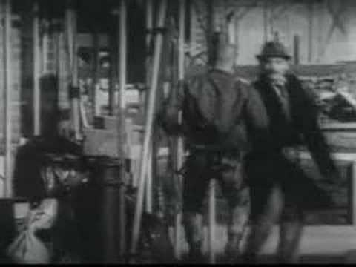
Differing Perceptions
People in different situations can perceive ‘reality’ differently.
  Recollection of events
  Different places at different times
“We see the world, not as it is, but as we are” – The Talmud
‘Points of View’ - Guardian Advertisement 1986
Notes:
Jarrah
Prime example of witnesses trying to recall a crime
Not questioning the reality of the crime being committed, just details being interpreted differently.
May have different perspective
Reality itself isn’t questioned, just the details of events that people may distort

Slide 11
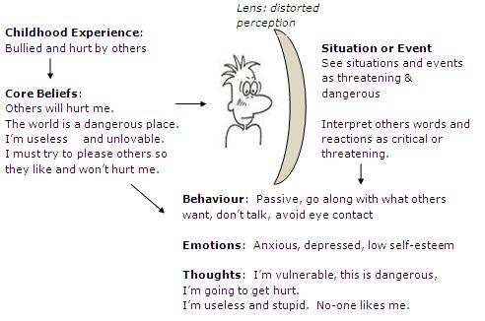
What Impacts our Perception
Notes:
Jarrah

Slide 12

Can An Objective Reality Exist?
Wrong to say there is no shared reality
  When we look at a tree for example, that tree would be part of the objective reality, as everyone looking at it would verify that it’s a tree
  Must be common reality among people.
Wrong to say all reality is shared
  Different perceptions of things
  Point of View couldn’t exist - no diversity
Notes:
Mitch

Slide 13
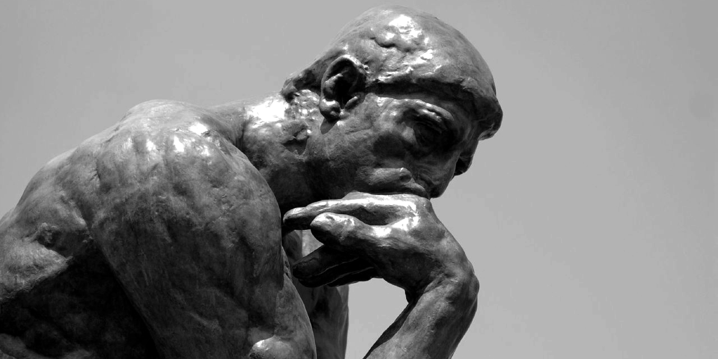
Nature of Reality
Philosophical Views
Notes:
Jarrah

Slide 14
Realism vs Idealism
• Realism is behavior or thought based on a conception of things as they are
Tendency to be practical and pragmatic.
• Idealism asserts that reality is fundamentally mental
Reality exists only as we know it, mentally constructed
Contemporary philosophical realism is the belief that some aspect of our reality is ontologically independent of our conceptual schemes, perceptions, linguistic practices, beliefs, etc
  Between realism and idealism
Notes:
Jarrah

Slide 15

Naive Realism
The senses provide us with direct awareness of the external world
We perceive objects as they really are
However, this doesn’t account for our experience that may change, or external factors that impact our perception
Notes:
Jarrah:
The senses provide us with direct awareness of the external world
We perceive objects as they really are.
They are composed of matter, occupy space and have properties, such as size, shape, texture, smell, taste and colour, that are usually perceived correctly.
Objects obey the laws of physics and retain all their properties whether or not there is anyone to observe them
This doesn’t account for our change in experience. If I observe an apple tree in the day time, I see the apples as a reddish colour. However, if it is night, then the apples appear a darker colour. Naive realism, if taken seriously, would mean that the apple actually changes its colour depending on the light. It is not our experience of the object, but the object itself that is changing.

Slide 16
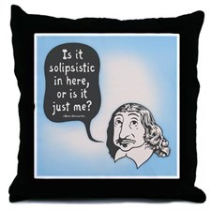
Solipsism
Only one's own mind is sure to exist
Epistemological:
  Knowledge of anything outside one's own mind is unsure
Metaphysical:
  The world and other minds do not exist
Notes:
Mitch
The senses provide us with direct awareness of the external world
We perceive objects as they really are.
They are composed of matter, occupy space and have properties, such as size, shape, texture, smell, taste and colour, that are usually perceived correctly.
Objects obey the laws of physics and retain all their properties whether or not there is anyone to observe them

Slide 17
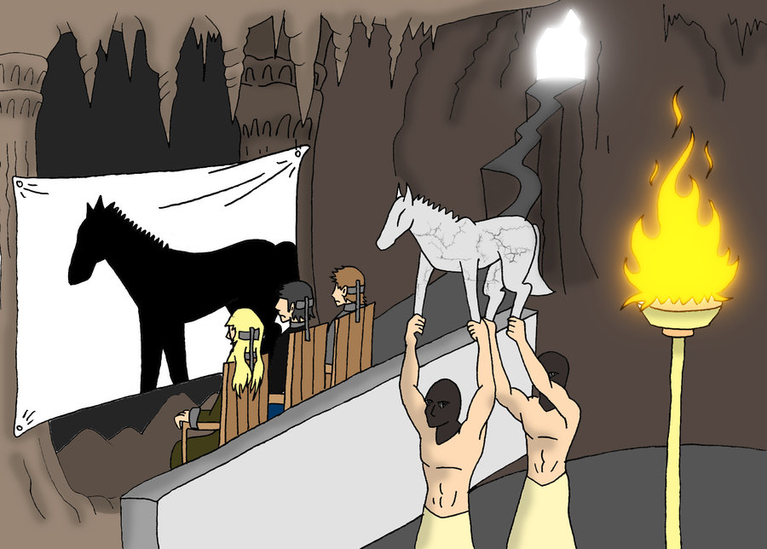
Reality as an Illusion
Plato’s Allegory of the Cave
Descartes' Evil Demon
Zhuang Zhou’s Butterfly Dream
Notes:
Mitch

Slide 18

Plato and his Cave
Plato’s Theory of the Forms:
- World of Appearances
- World of the Forms
• Our reality is a representation of the true form of reality in the World of the Forms
• Uses the Allegory of the Cave to explain this
Notes:
Jarrah

Slide 19
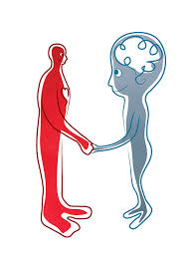
Rene Descartes
Cartesian Dualism:
  Relationship between the mind and the body
Cogito Ergo Sum
  ‘I think, therefore I am’
  Thinking requires a thinker, therefore you exist
We perceive our body through our senses, but they have been deceived before.
  Only indubitable knowledge is that we are ‘thinking beings’.
Notes:
Mitch
Explored the relationship between the mind and the body.
Cartesian Dualism
Cogito Ergo Sum
The fact that you may be skeptical about our existence proves that you exist
But in what form?
Existence is independent of our body
We perceive our body through our senses, but they have been deceived before.
Only indubitable knowledge is that we are ‘thinking beings’.

Slide 20
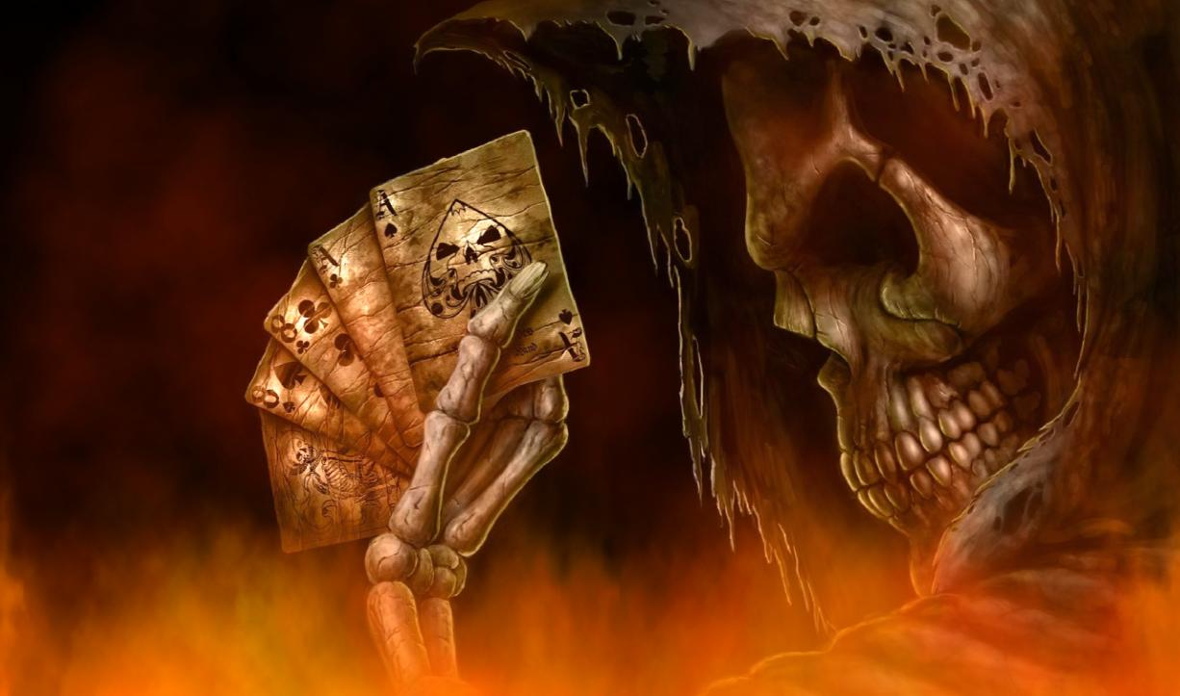
Rene Descartes
Wax Argument
  “And so something that I thought I was seeing with my eyes is in fact grasped solely by the faculty of judgment which is in my mind.”
The Evil Demon
  Presents a complete illusion of an external world
Notes:
Mitch
Descartes defines "thought" (cogitatio) as "what happens in me such that I am immediately conscious of it, insofar as I am conscious of it".
Thinking is thus every activity of a person of which the person is immediately conscious.
To further demonstrate the limitations of our senses, Descartes proceeds with what is known as the Wax Argument
“And so something that I thought I was seeing with my eyes is in fact grasped solely by the faculty of judgment which is in my mind.”
The Evil Demon
Presents a complete illusion of an external world

Slide 21
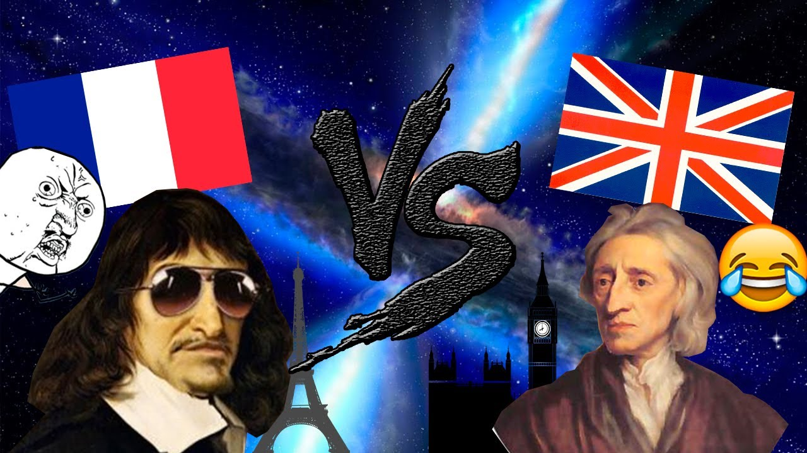
Empiricism
John Locke and David Hume opposed Descartes rationalism
Locke was an empiricist, so believed knowledge came from our senses.
“There are no ideas without impressions.” - Hume
  Eg. a blind person cannot possess the concept of colour
Sensory experience vs thought
Notes:
Jarrah
Two views that opposed Descartes' dualism.
Locke was an empiricist, so believed knowledge came from our senses.
“There are no ideas without impressions.” - Hume
We cannot possess a concept without first having an experience (impression) of it
Eg. a blind person cannot possess the concept of colour
So both Locke and Hume claim that any concept we possess must be traceable to a sensory experience.
Whereas Descartes was a rationalist, believing reality could be discovered through thought alone, without having to examine the world.

Slide 22
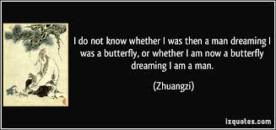
The Butterfly Dream
Zhuangzi dreamed he was a butterfly
Woke up, but wasn’t sure if he was actually dreaming he was a human
How do we know that we’re awake?
Notes:
Jarrah
Zhuangzi once dreamed that he was a butterfly, and then ‘woke up’, and was a human again, but was he a butterfly dreaming that he was a human or a human dreaming we was a butterfly.
The relationship between the ‘waking state’ and ‘dream state’.
How do we know that we’re awake.

Slide 23
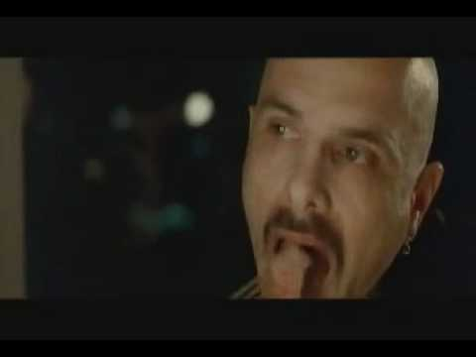
Conclusion
Our perception of reality may not be the ‘true reality’, but it’s our reality, the one we’re living in everyday
Is it really going to change how we live?
Notes:
Mitch

